Slide 1

Barriers and bottlenecks for innovation in the water sector
Skoulikaris Haris
Aristotle University of Thessaloniki
Workshop on innovative practices in the EU water sector: barriers and opportunities / Vienna, 8-10 May 2019
This project has been funded with support from the European Commission. This publication reflects the views only of the author, and the Commission cannot be held responsible for any use which may be made of the information contained therein.

Slide 2
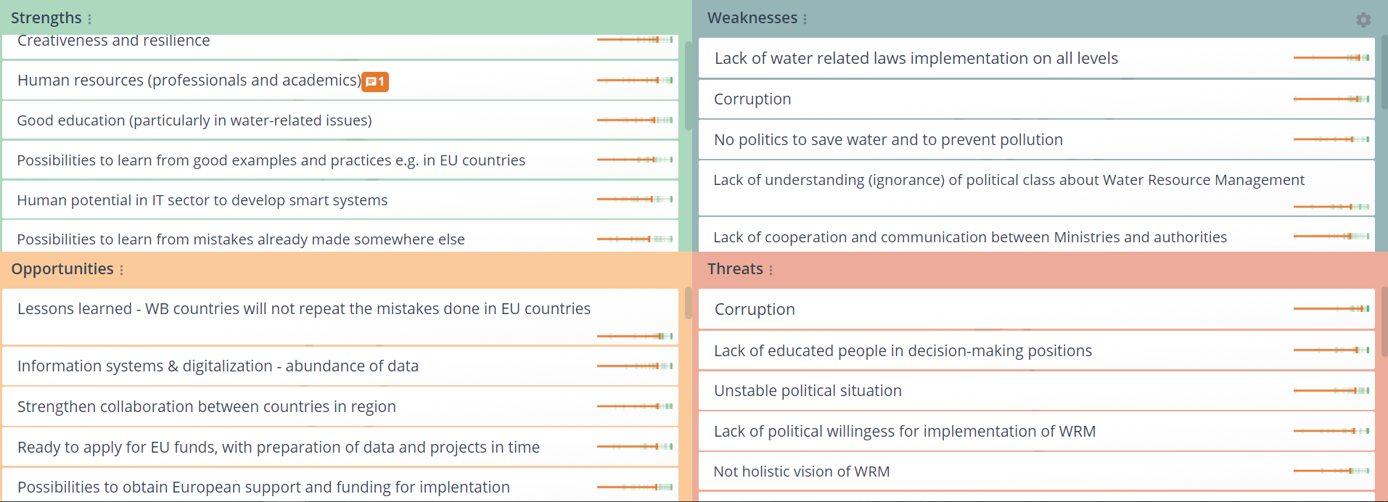
Barriers and bottlenecks as defined in the SWOT analysis performed by WB partners
Strengthening of master curricula in water resources management for the Western Balkans HEIs and stakeholders
www.swarm.ni.ac.rs

Slide 3
Opportunities for WRM in the WB
Skoulikaris Haris
Aristotle University of Thessaloniki
Workshop on innovative practices in the EU water sector: barriers and opportunities / Vienna, 8-10 May 2019
This project has been funded with support from the European Commission. This publication reflects the views only of the author, and the Commission cannot be held responsible for any use which may be made of the information contained therein.

Slide 4
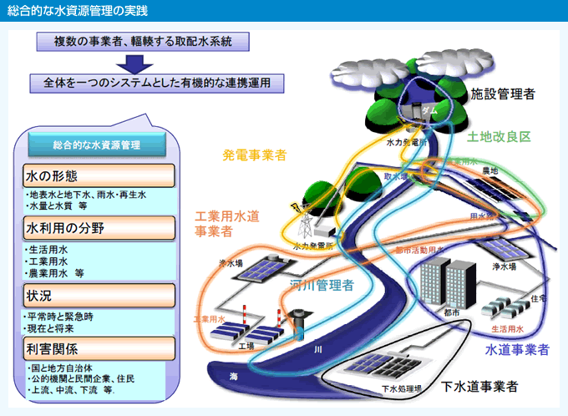
Sustainable and integrated WRM

Slide 5


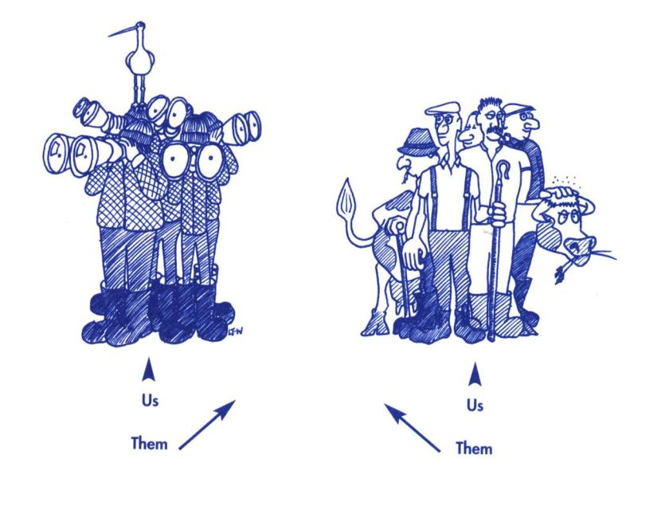


Slide 6
Water Resources Management
The traditional practice focused on the management of water resources exclusively as a means to serve and meet the human needs
Scientific expertise + economic development
against the environment

Slide 7
Sustainable Water Resources Management
ENVIRONMENTAL SAFETY
ENVIRONMENT
ENVIRONMENTAL FAILURE
Economic development, scientific expertise
+
Social development, environmental protection
TECHNICAL RELIABILITY
ENGINEERING
TECHNICAL
FAILURE
ECONOMIC
LOSSES
ECONOMIC EFFECTIVENESS
RISKS
ECONOMY
SOCIAL
DISRUPTION
SOCIETY
SOCIAL
EQUITY
The integration of the sustainable development concept into water resources management practices is considered indispensable for succeeding in the protection of the water resources while fulfilling the water demands of economic development

Slide 8
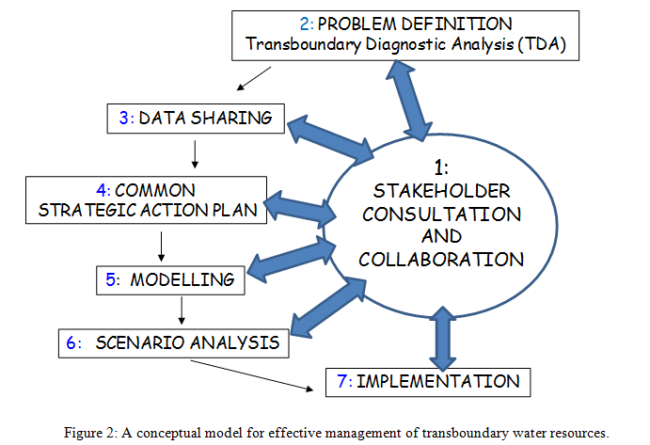
Management of transboundary GWB
Πηγή: Ganoulis, J., Skoulikaris, Ch. (2011). A Conceptual Model for Implementing Integrated Transboundary Water Resources Management (ITWRM). Journal of Hydrologic Environment, 7(1), 155-158

Slide 9
Modeling Coupling for the
Integrated Water Resources Management
Climate change
models
Hydrological
data
Sediment transport models
Climatic
data
Hydrology model
(Runoff? Quality? Aquifers?)
Economic models
GIS
Reservoirs’
simulation
Open MI
….
Agriculture modeling
DSS tools
IWRM

Slide 10
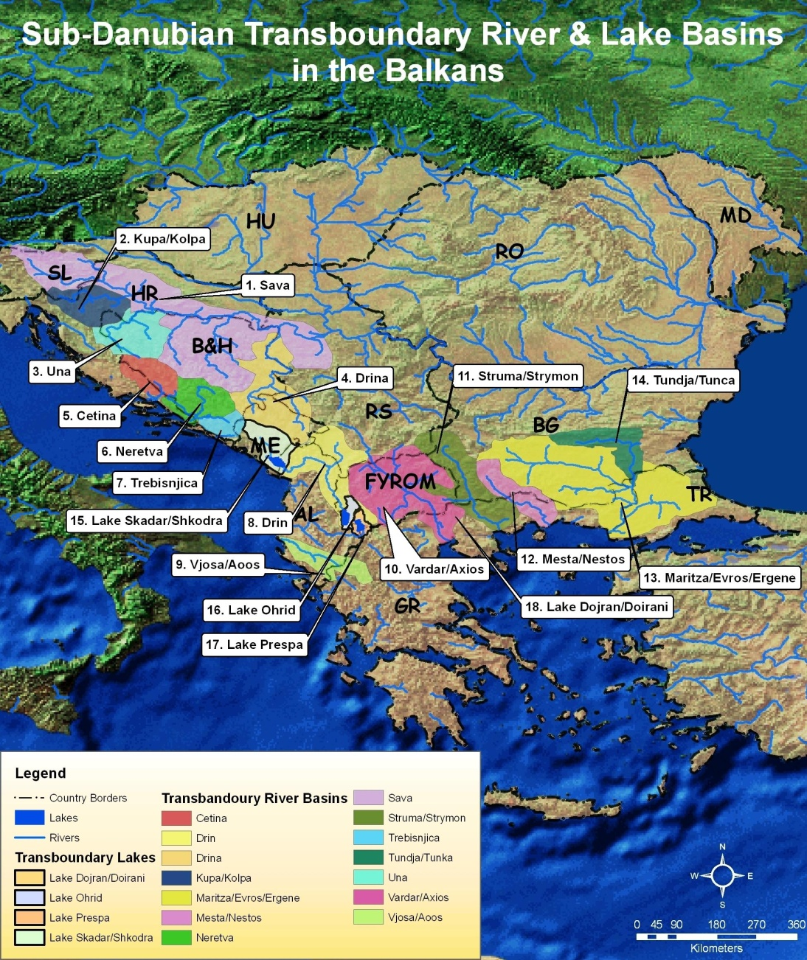
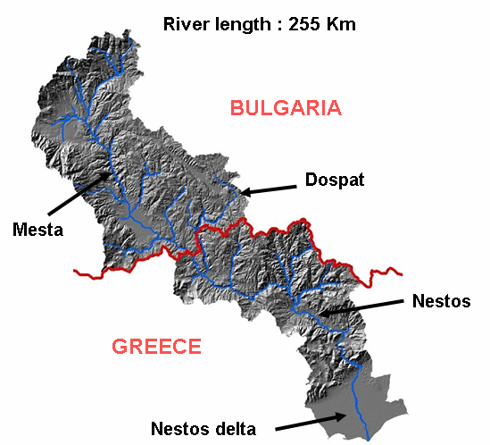
Integrated Management of water resources projects
Surface: 6.218 Km²

Slide 11
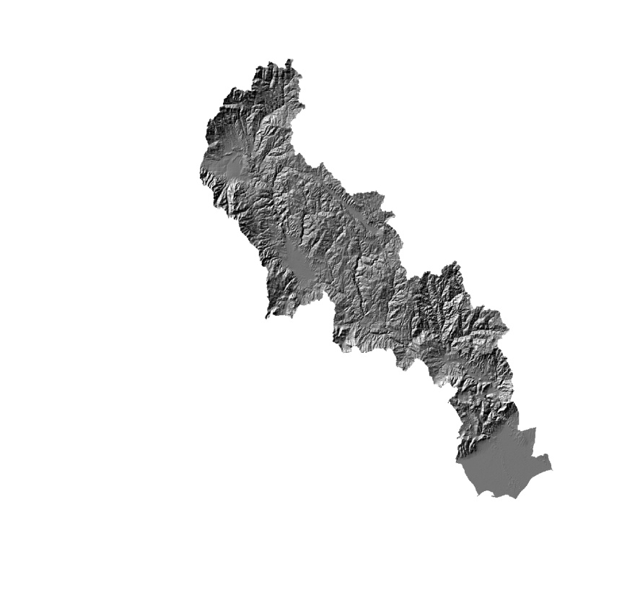
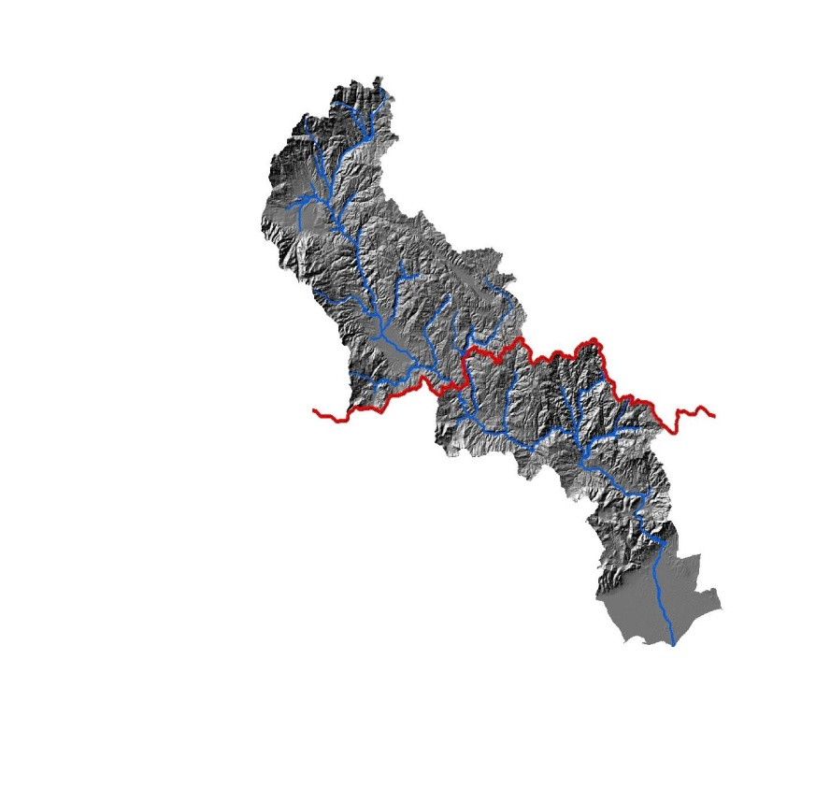
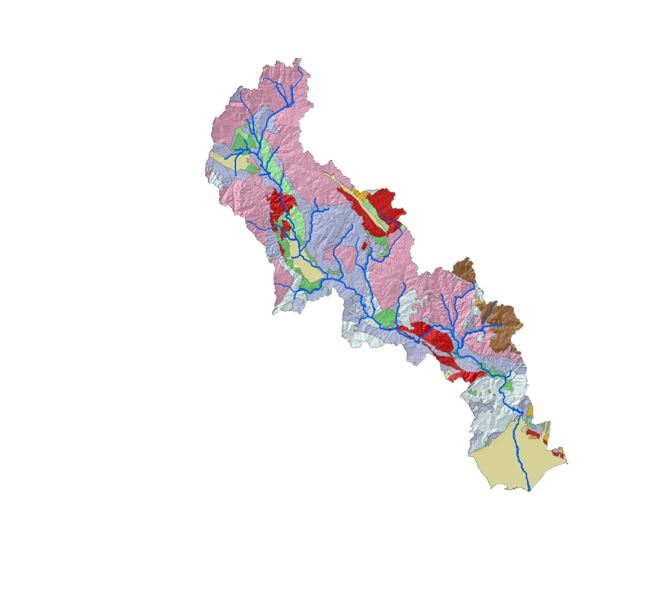
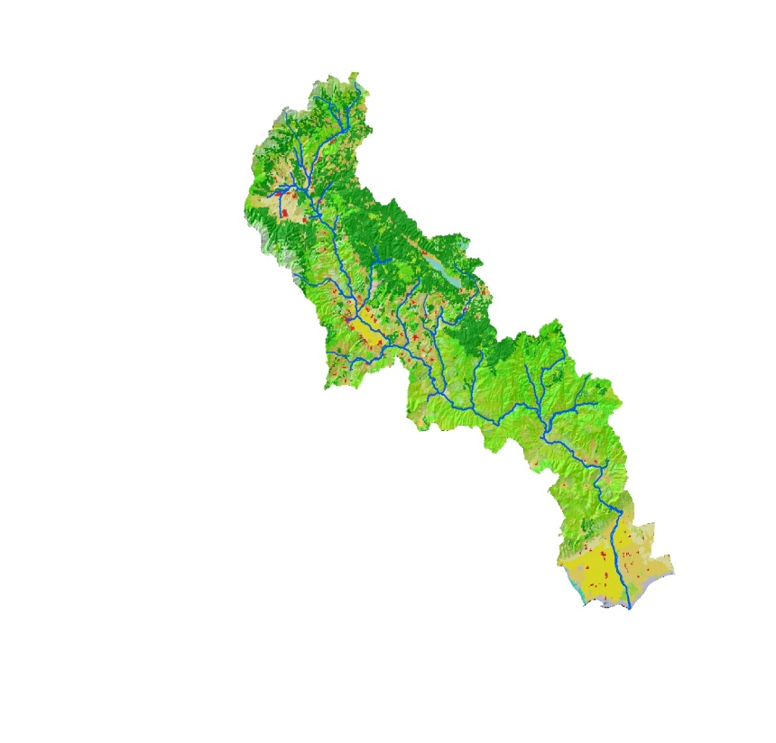
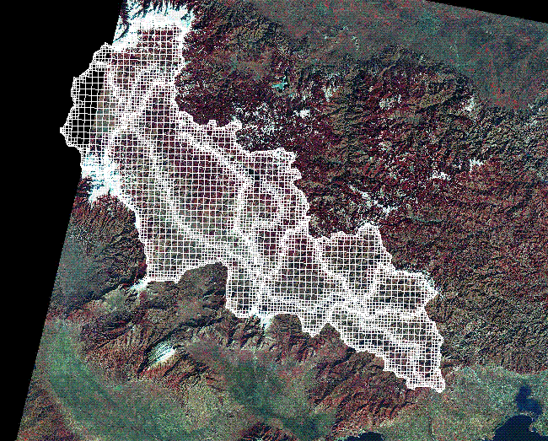
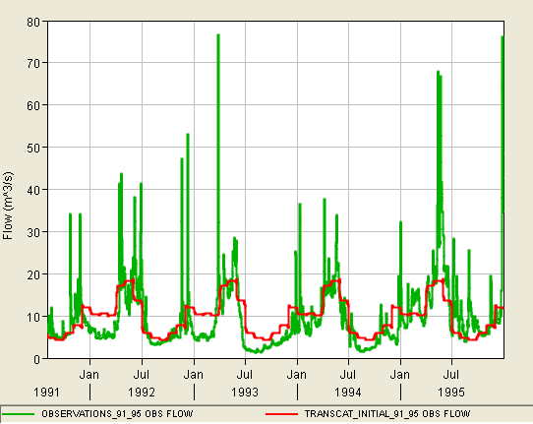
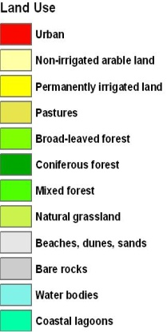
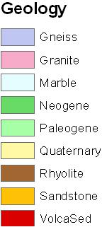
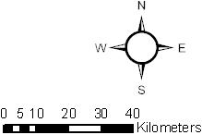
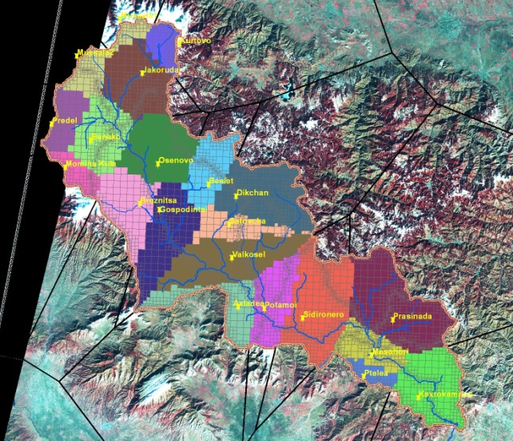
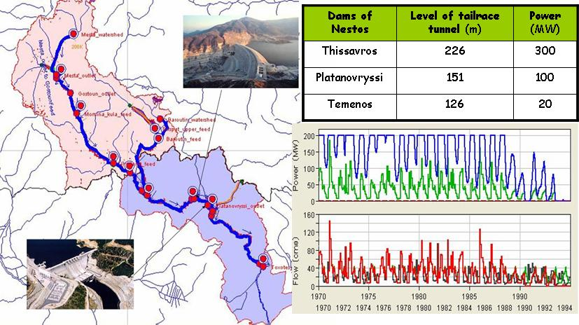
Geographic Information Systems - GIS
Hydrologic modelling
Mont du Rila
Mussala – 2925m
Le bassin du Mesta-Nestos
Surface : 6.218 Km²
Length: 255 Km
Granites et
roches métamorphiques
BULGARIE
Mont du Pirin
Vihren – 2915m
Dospat
Mesta
Nestos
Marbres
GRECE
Delta du Nestos
Alluvions récentes
Meteorological data
Reservoir simulation

Slide 12
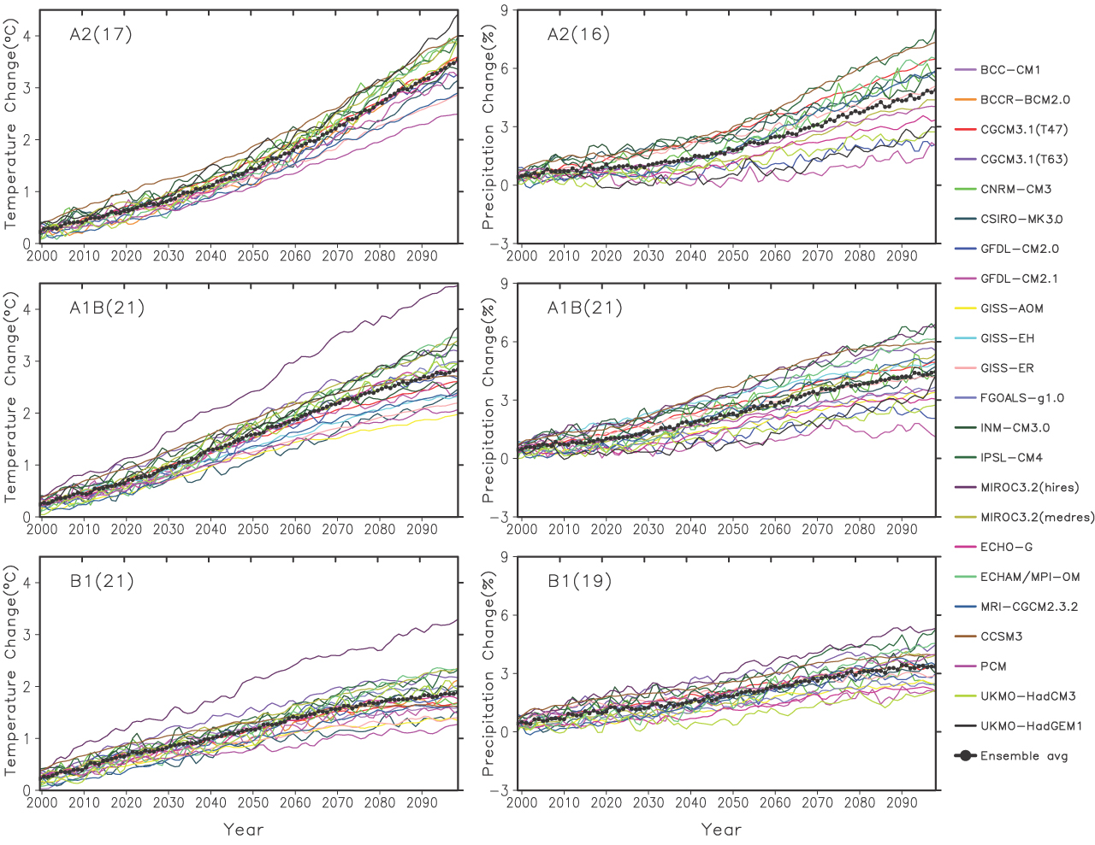
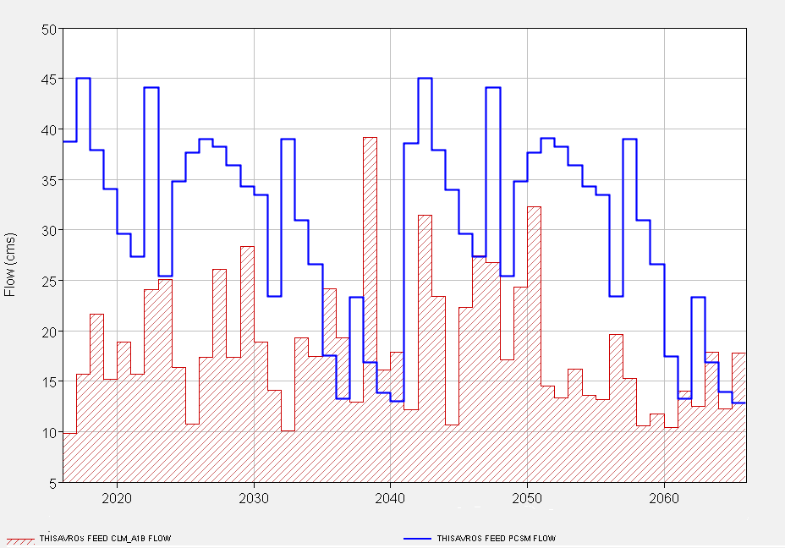
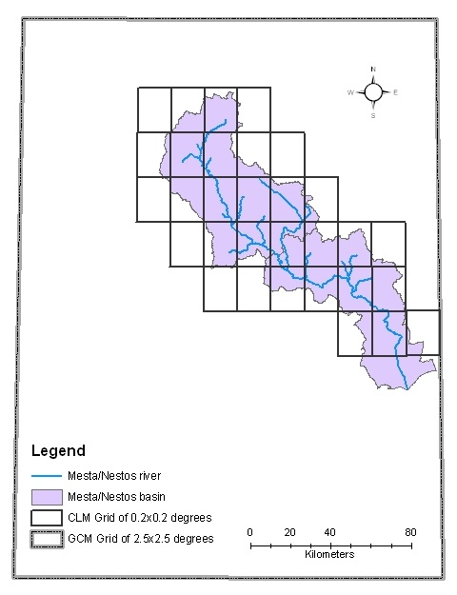
Climate change models
CURRENT SITUATION
Downscaling techniques
A1B,REALISTIC

Slide 13
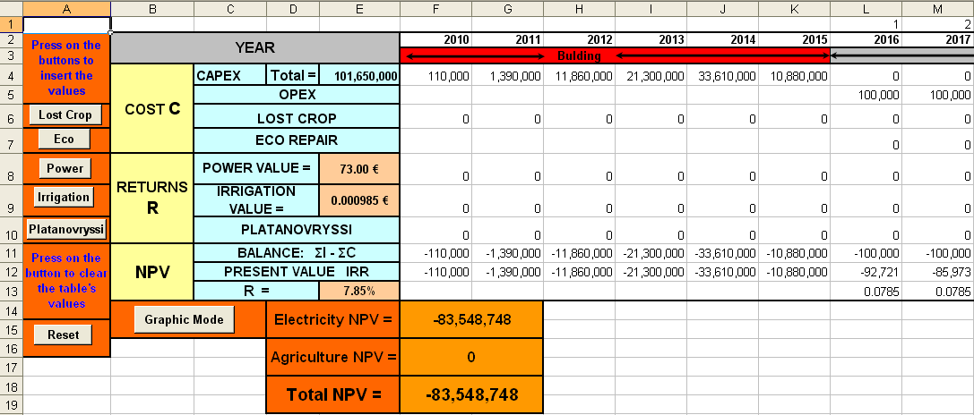
Economic model
A1B

Slide 14
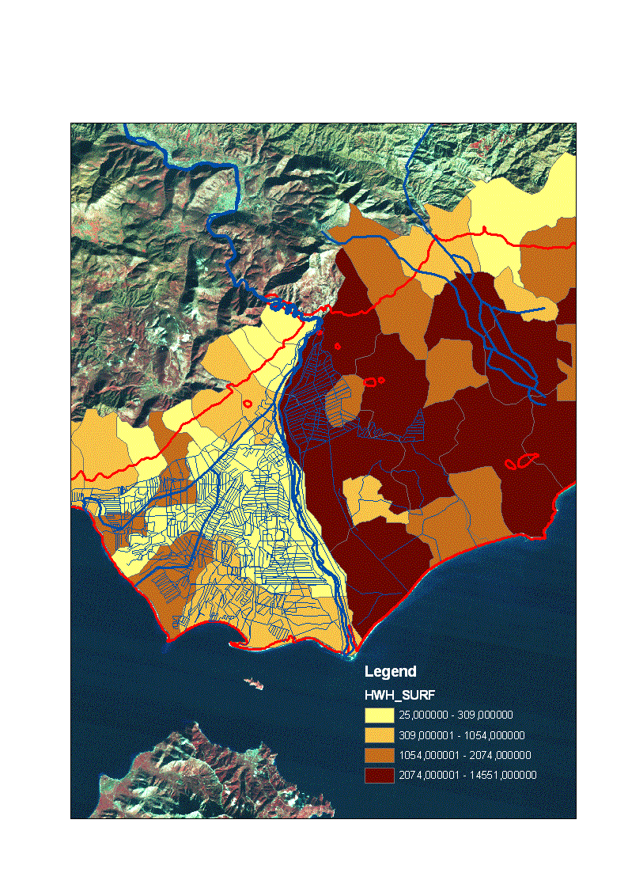
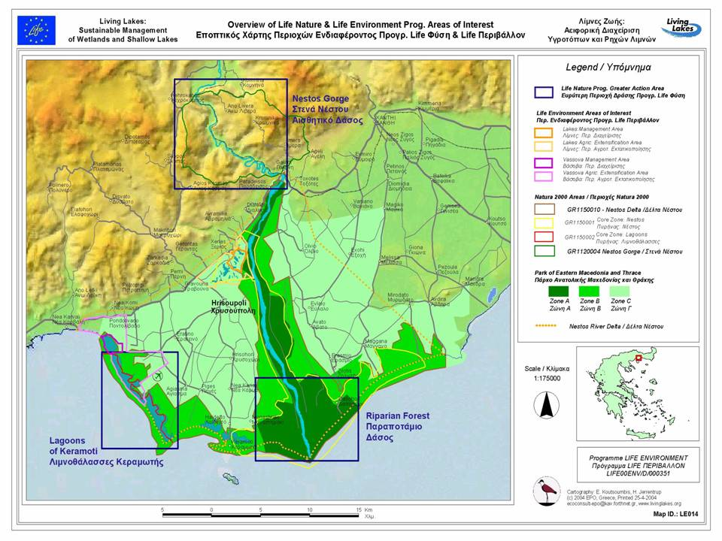
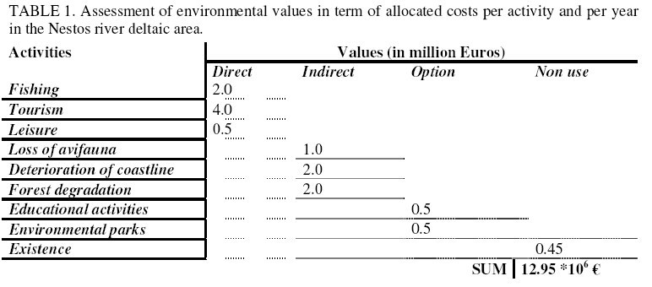
Restrictions
Compensation to farmers in case of lack of water. Thus, use of agricultural statistics
Valuing the environmental flow

Slide 15
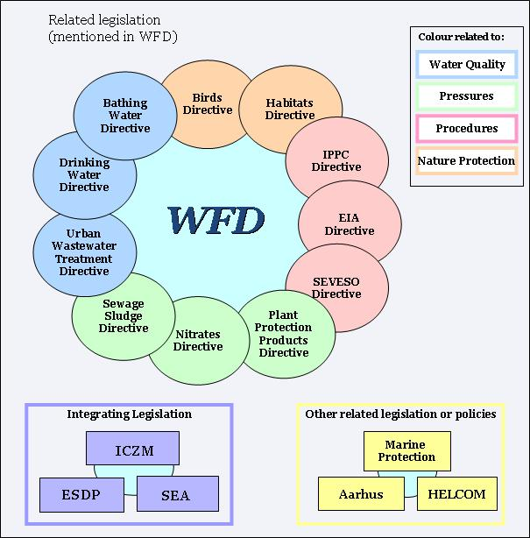
WFD and connected ICTs

Slide 16
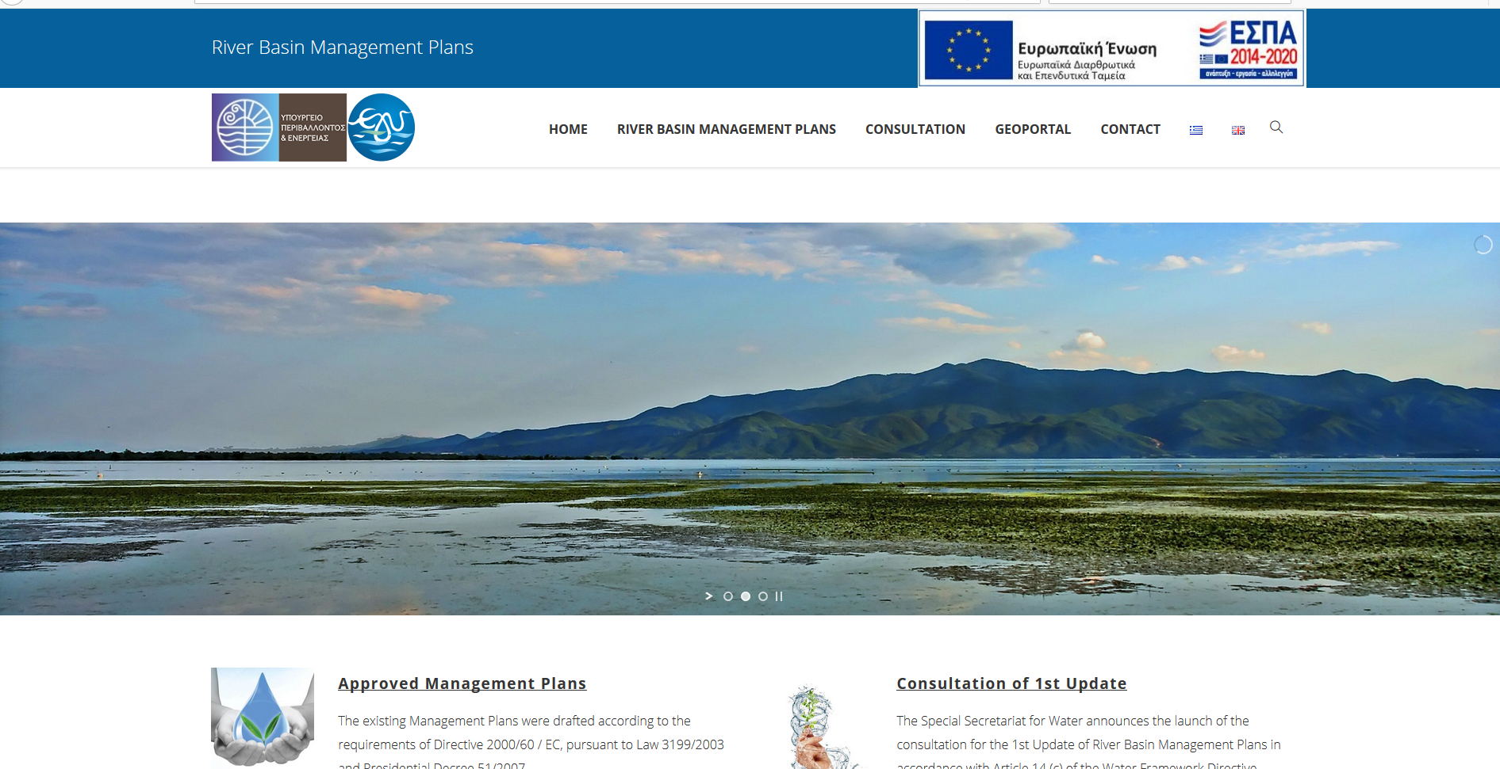
WFD in Greece
http://wfdver.ypeka.gr/en/home-en/

Slide 17
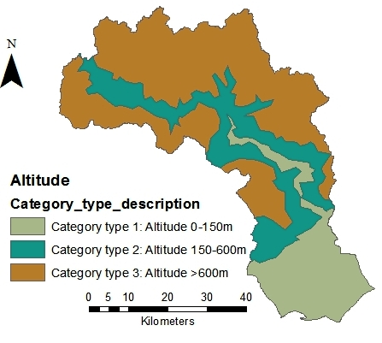
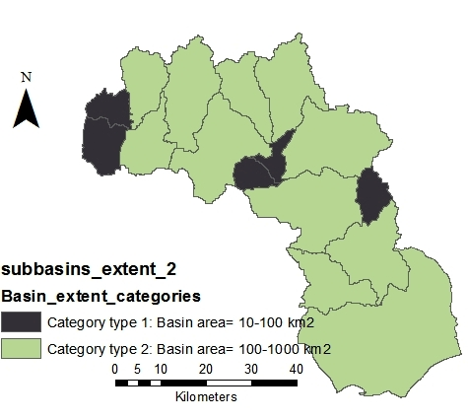
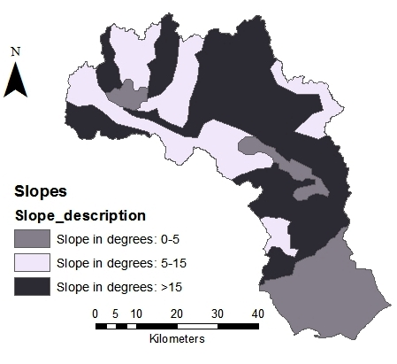
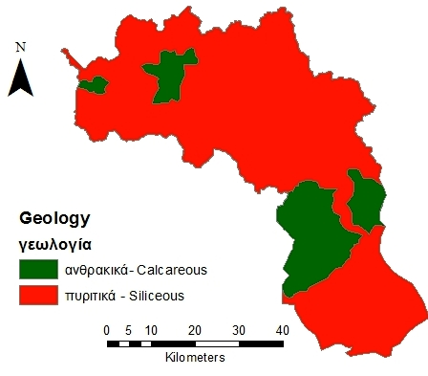
Results of application of Typology B

Slide 18
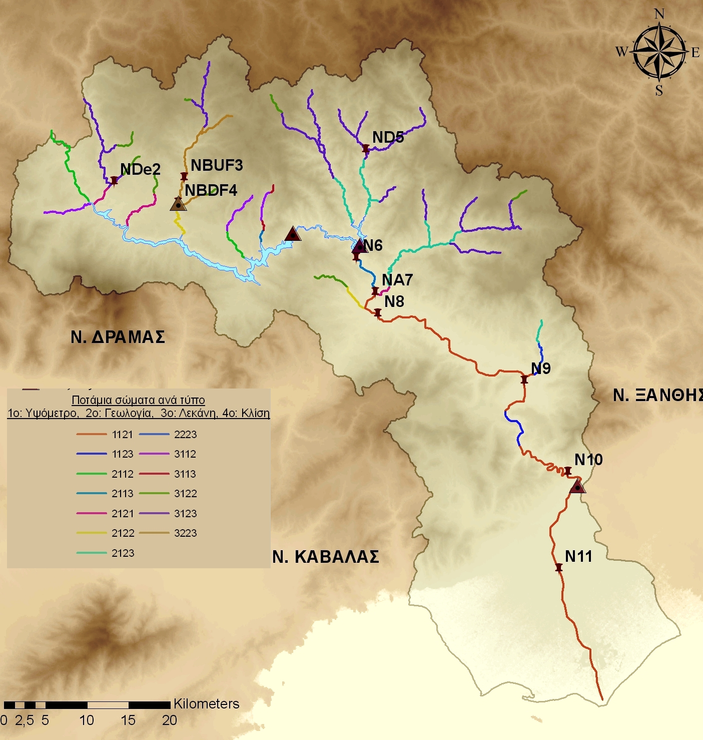

Slide 19
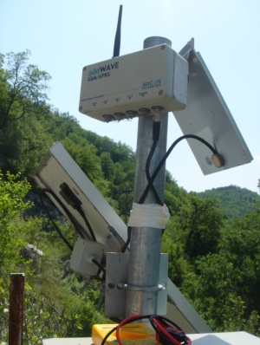
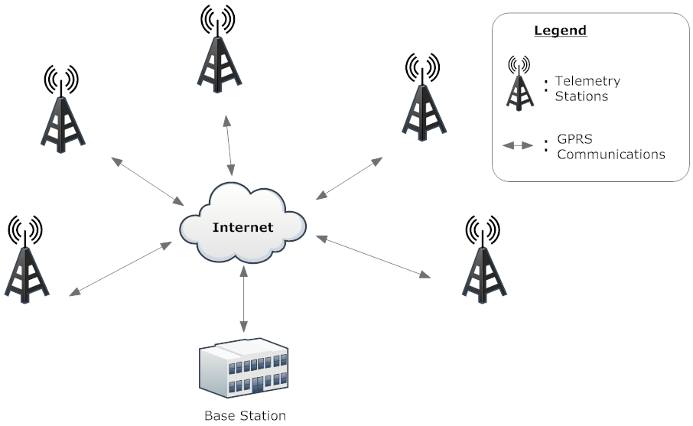
Telemetry monitoring systems – Gauging stations
Telemetric Equipment
Measuring sensors kit
Energy independent (use of solar panels)
Doppler flow sensors and meteorological stations
Remote Telemetry Unit (RTU) (Data logger for measurements storage and transmission of data)
GPRS data communication
Internet of things!

Slide 20
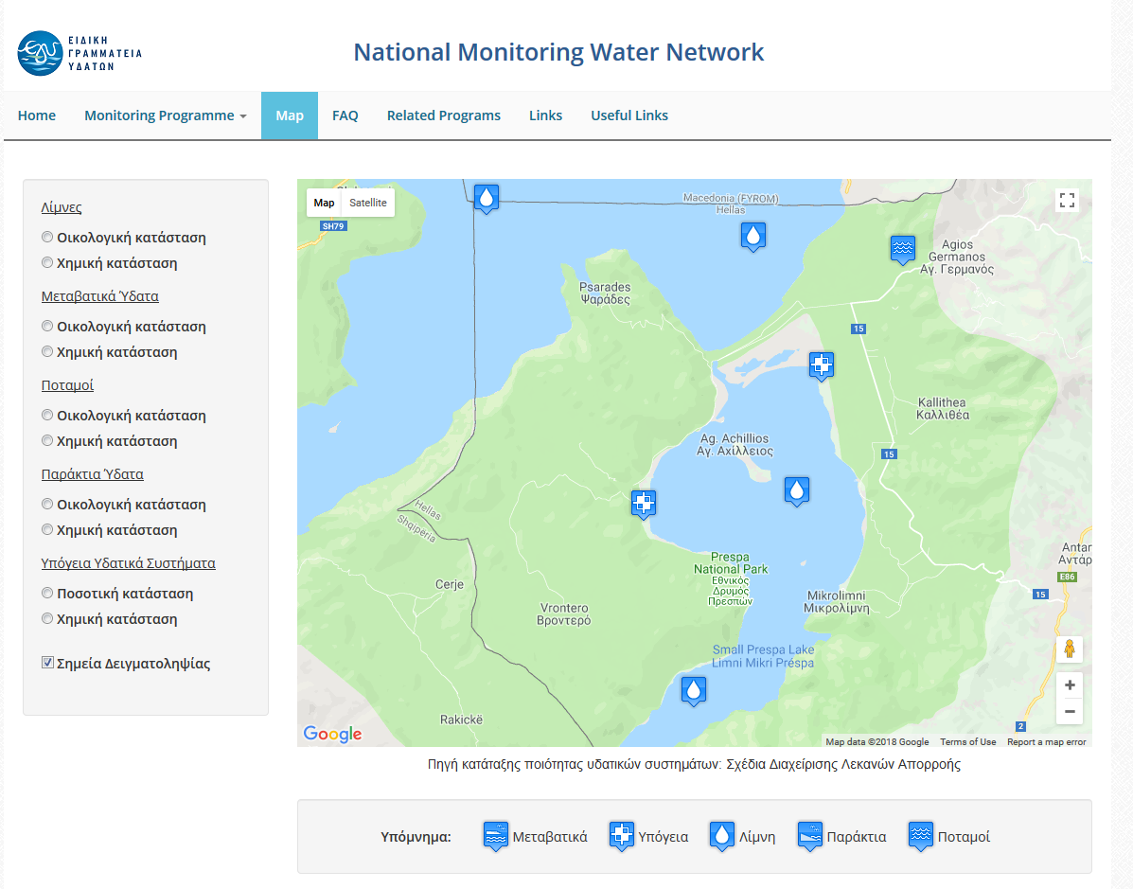
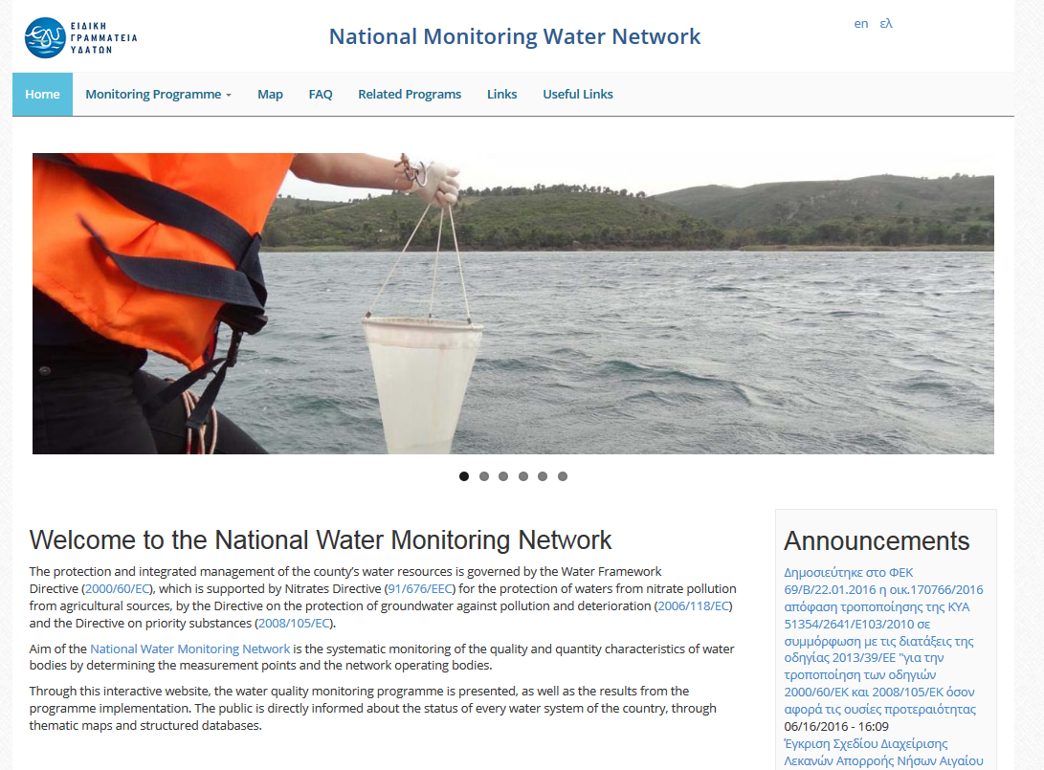
Responses for the common waters
Common monitoring programmes
http://nmwn.ypeka.gr/en
Greece

Slide 21
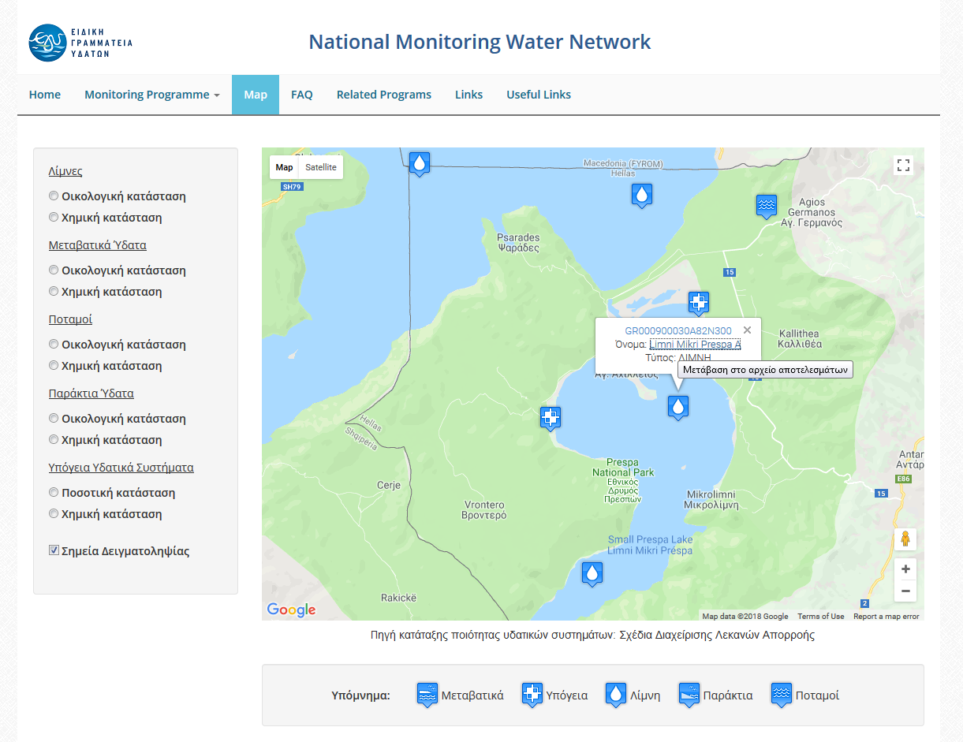
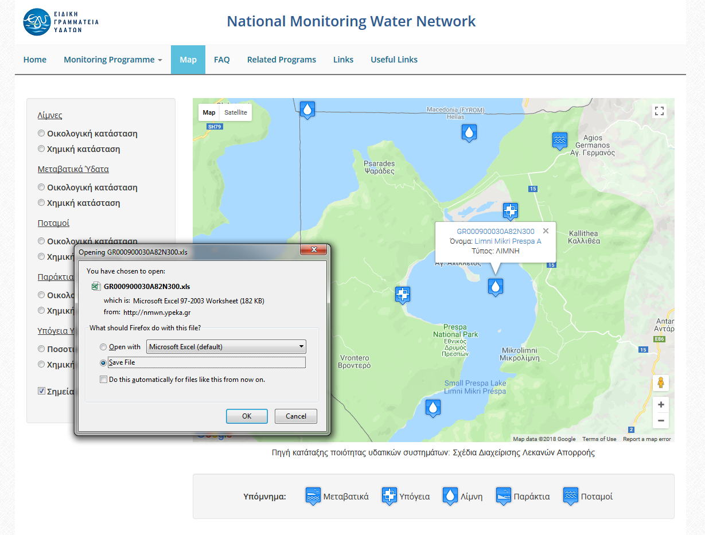
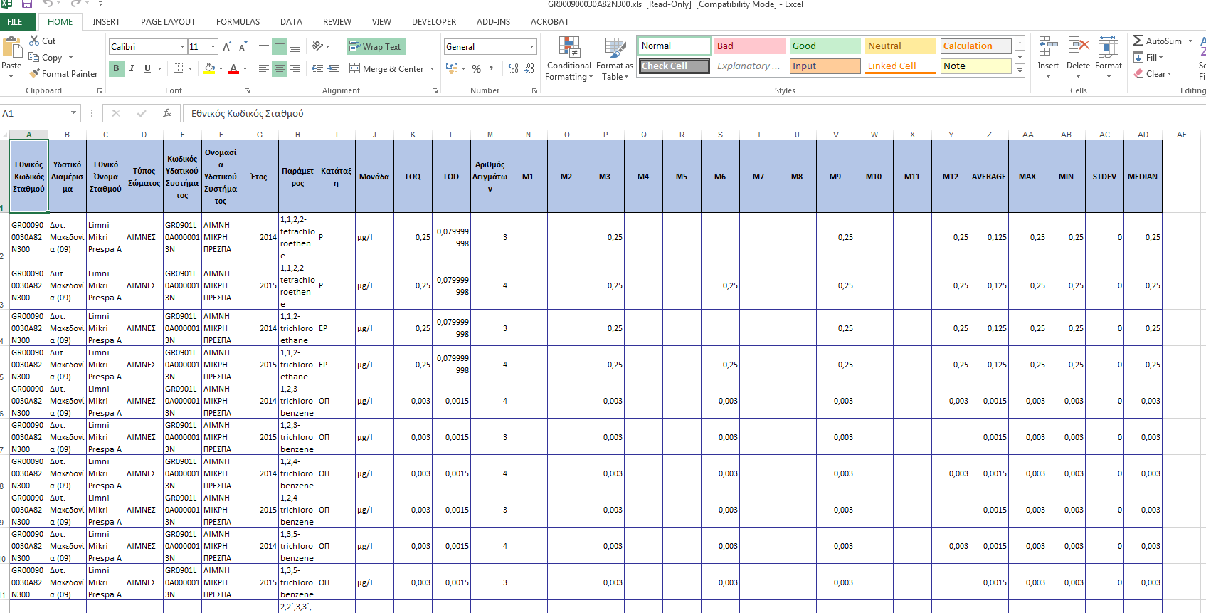
Responses for the common waters
Common monitoring programmes
http://nmwn.ypeka.gr/en
Greece

Slide 22
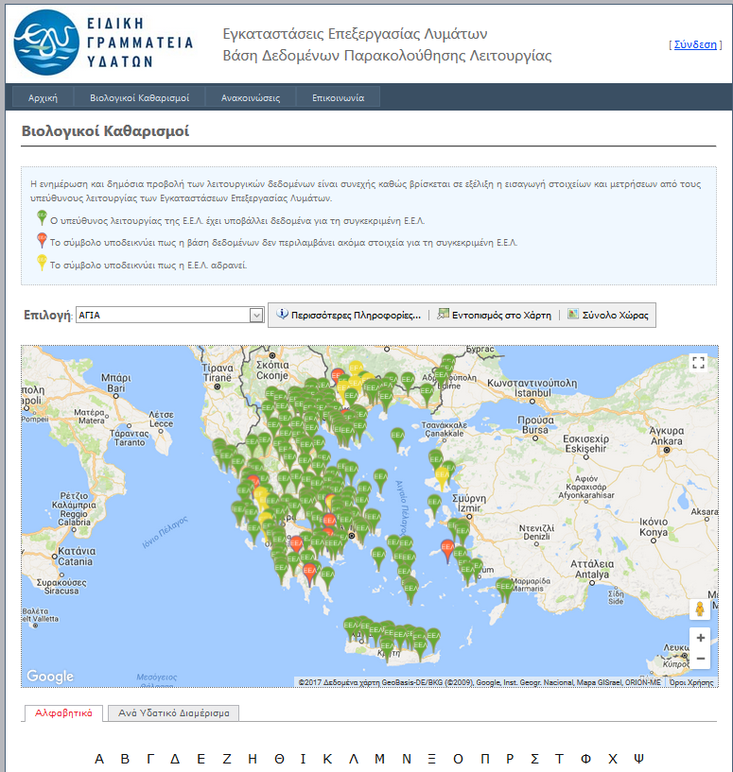
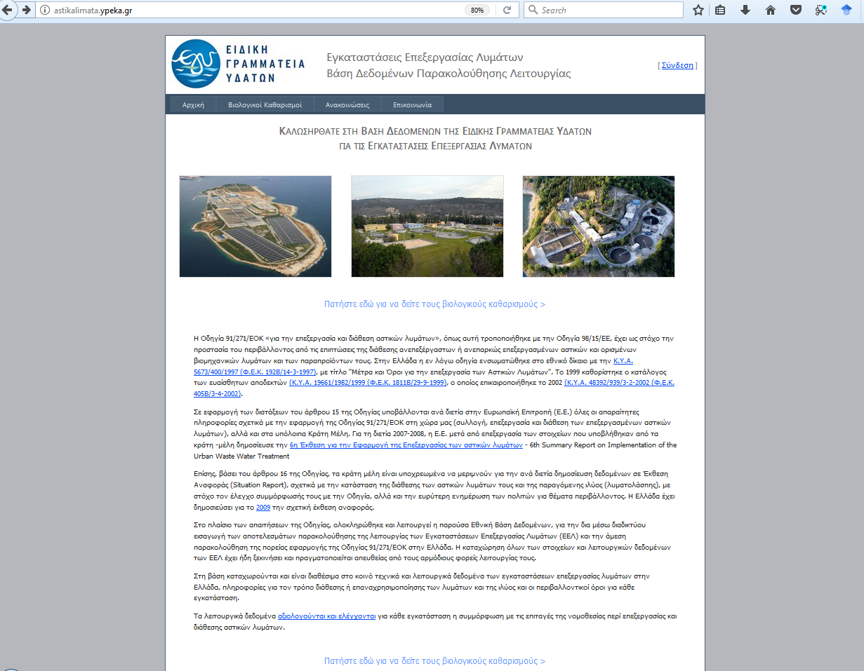
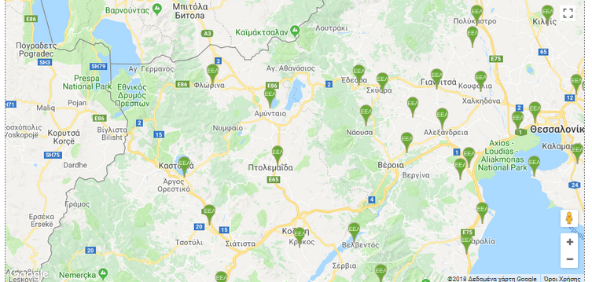
Waste Water Management in Greece - WWTPs
Legislation: Directive 98/15/EU “The Urban Waste Water Treatment Directive”
http://astikalimata.ypeka.gr/

Slide 23
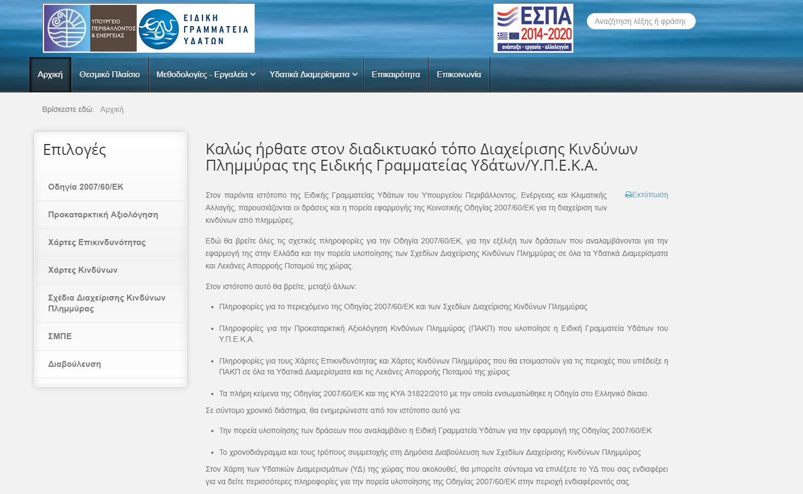
http://floods.ypeka.gr/

Slide 24
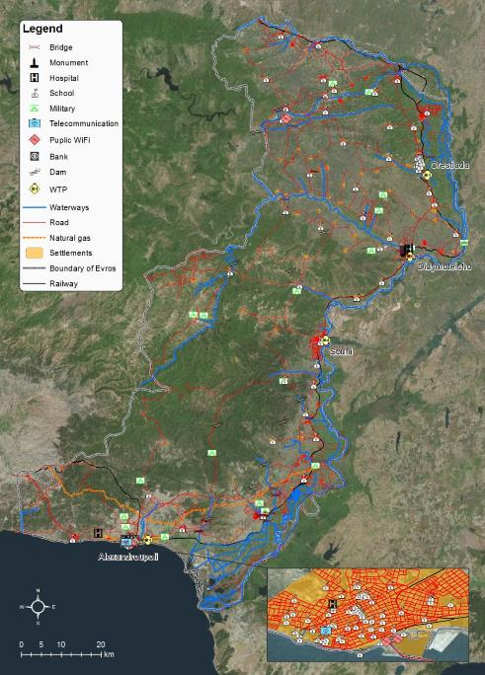

Slide 25
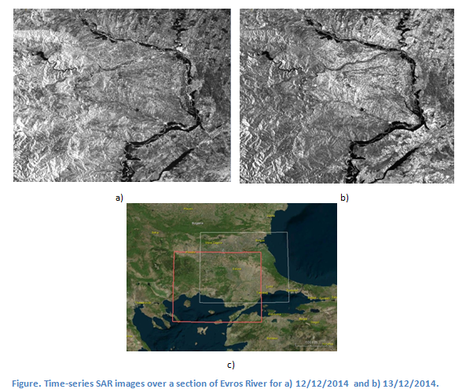

Slide 26
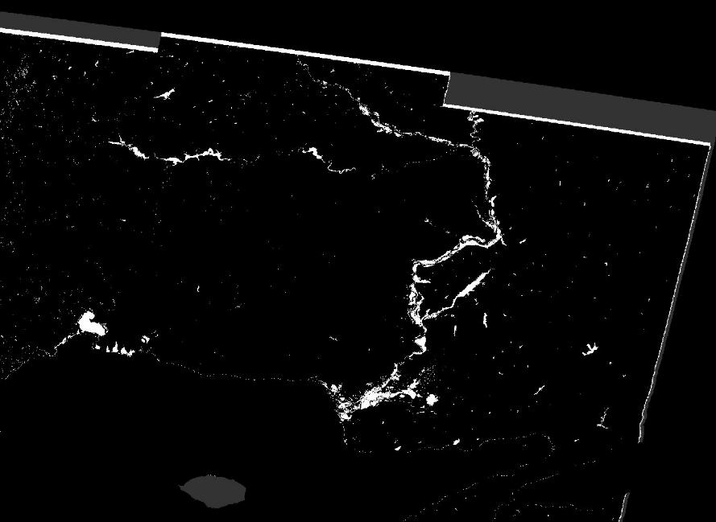

Slide 28


Use of GIS for the creation of geodatabases
Database is a collection of information organized in such a way that a computer program can quickly select desired pieces of data.
Geodatabase is the common data storage and management framework for ArcGIS. It combines "geo" (spatial data) with "database" (data repository) to create a central data repository for spatial data storage and management.
The serving of georeferenced data that are stored in geodatabases over the Internet is based on the technology known as Web Map Service (WMS).

Slide 29
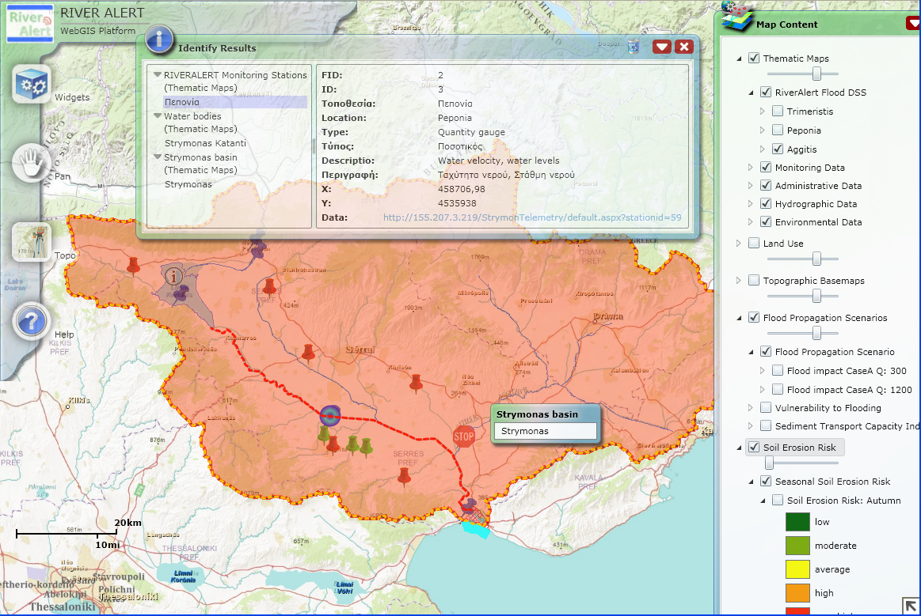
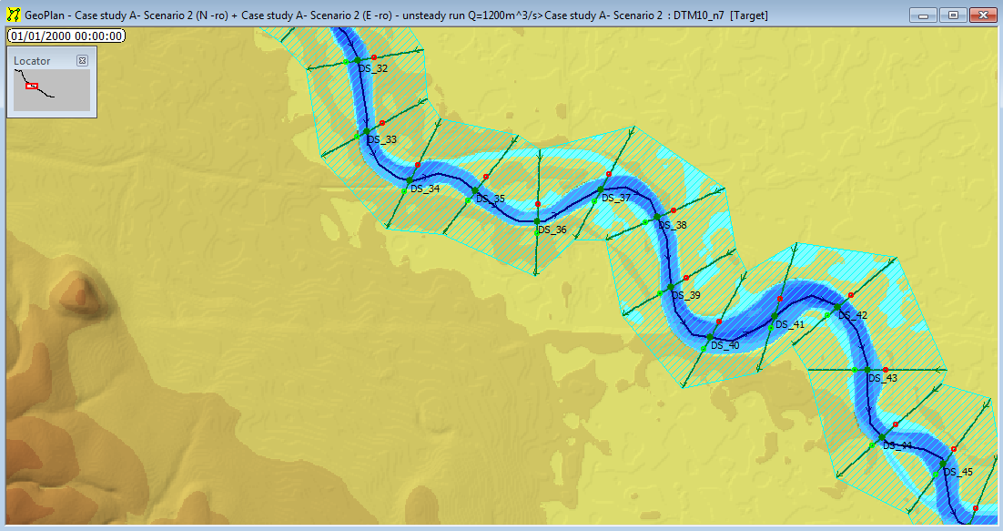
WebGIS for real time monitoring

Slide 30
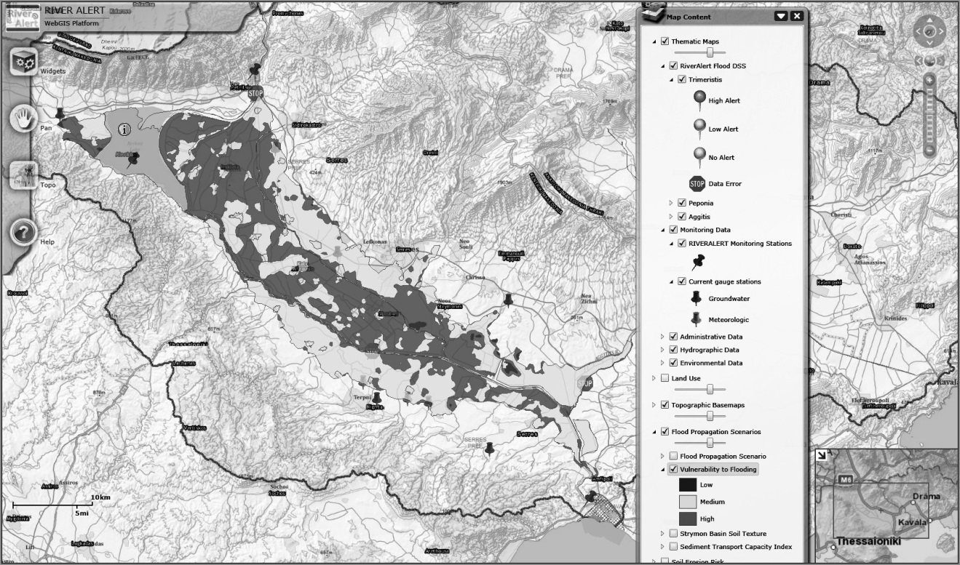
WebGIS for real time monitoring
Illustration of monitoring stations and their operational status, and the area’s vulnerability to floods for the Greek part of the Strymon transboundary river basin (Skoulikaris et al., 2014-IAHS Publications 363)

Slide 31
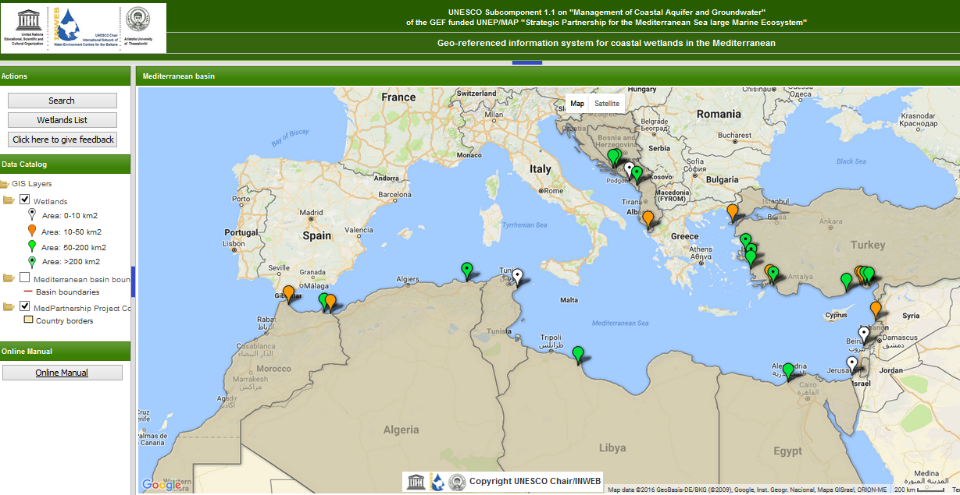
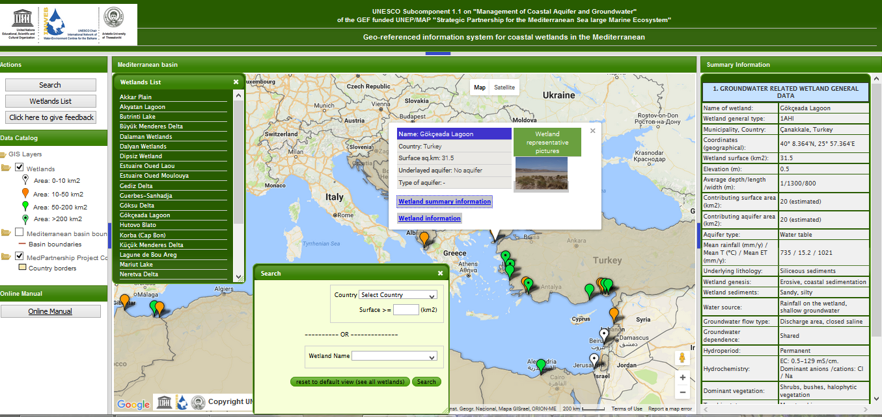

Slide 32



Slide 33

Remote sensing and GIS for water resources management

Slide 34
ArcGIS: Statistics (Analysis)
The Statistics toolset contains tools that perform standard statistical analysis (such as mean, minimum, maximum, and standard deviation) on attribute data as well as tools that calculate area, length, and count statistics for overlapping and neighboring features.
Tool | Description
Frequency | Reads a table and a set of fields and creates a new table containing unique field values and the number of occurrences of each unique field value.
Polygon Neighbors | Creates a table with statistics based on polygon contiguity (overlaps, coincident edges, or nodes).
Summary Statistics | Calculates summary statistics for field(s) in a table.
Tabulate Intersection | Computes the intersection between two feature classes and cross-tabulates the area, length, or count of the intersecting features.

Slide 35
ArcGIS : Spatial analyst, Interpolation
The assumption that makes interpolation a viable option is that spatially distributed objects are spatially correlated; in other words, things that are close together tend to have similar characteristics.
Tool | Description
IDW | Performs an inverse distance weighted interpolation on a point dataset.
Krige | Interpolates a raster from a set of points using kriging.
Kriging | Interpolates a grid from a set of points using kriging.
Natural Neighbor | Interpolates a surface from points using a natural neighbor technique.
PointInterp | Interpolates a raster from a set of points using a specified neighborhood.
Spline | Performs a two-dimensional minimum curvature spline interpolation on a point dataset resulting in a smooth surface that passes exactly through the input points.

Slide 36


ArcGIS: Statistics (Analysis)

Slide 37




ArcGIS : Computation of equivalent rainfall
Computation of equivalent rainfall per subbasin:
Where
K: the number of stations
h_{i}: point rainfall (mm)
w_{i}: the weight factor

Slide 38


ArcGIS : Example with Kriging
The Inverse Distance Weighted (IDW) and Spline methods are referred to as deterministic interpolation methods because they are directly based on the surrounding measured values.
Kriging is based on statistical models that include autocorrelation—that is, the statistical relationships among the measured points

Slide 39


Slide 40

ΥΔΡΟΛΟΓΙΚΗ ΠΡΟΣΟΜΟΙΩΣΗ
Ευχαριστώ!!!

